Slide 1
Department for Interdisciplinary Research in Management
INTERNATIONAL
BUSINESS PROJECTS
2024/2025
inter.fon.bg.ac.rs

Slide 2
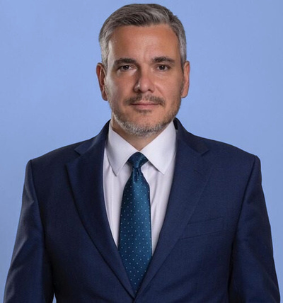
PROFESSORS
Prof. dr Vladimir Obradović
Prof. dr Marija Todorović
Doc. dr Danijela Toljaga- Nikolić
Full professor, Module leader
Full professor
Assistant professor

Slide 3
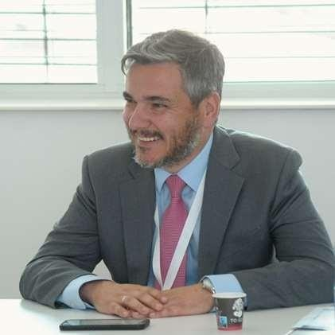
Vladimir Obradovic
Professor at:
Faculty of Organizational Sciences, Head of the Department for Interdisciplinary Research in Management
Alma Mater University , Austria/Slovenia
HSE University, Moscow (Visitor)
State University of Management, Moscow
Faculty of Political Science, University of Belgrade
Editor of the European Project Management Journal (Scopus)
President of the Project Management Association of Serbia – IPMA Serbia
Vice-President of IPMA International Project Management Association – IPMA (70 countries)
IPMA Level A Certified Coach, Consultant® and Trainer
More than 20 years of experience in PM in Serbia and the world

Slide 4
Assessment
Individual coursework
40%
Group coursework 20%
Examination
40%
Students need to pass coursework and examination and have minimum 50% in order to pass the module according to the following structure: individual coursework (minimum 20%), group coursework (minimum 10%) and examination (minimum 20%).

Slide 5
SYLLABUS
Project management approaches and methodologies
The role of projects in the organizational development and development of a society
International business projects
Project management process
Tools and practices for managing business projects
Project management governance
Competencies for project management in international environment
Diversity in project management
Project leadership
Sustainable and responsible project management

Slide 6
Lecture topics
1/2
Week 1
Week 3
Week 5
Business projects;
The role of projects in the organizational development and development of a society;
Project management approaches and methodologies
Project management process
People competences in project environment – Resourcefulness; Result orientation;
Negotiation;
Conflicts and crisis
2024
Week 6
Project management governance;
Project Management Office;
Communication skills;
Relationships and engagement
Week 2
Week 4
Organizational strategy and projects;
Portfolio management;
Prioritization of programs and projects
People competences in diverse project environment – Teamwork;
Leadership

Slide 7
Lecture topics
2/2
Week 7
Week 9
Week 11
Diversity in project management;
Human resource management in project environment;
Project career development
Project evaluation
Group coursework – Project Management Business Game
Week 8
Week 10
Week 12
Project change management
Sustainable and responsible project management
Project proposals presentations

Slide 8
Key elements of the project proposal
Project description
Project objectives and deliverables
Project Scope
Assumptions
Constraints
Project structure and Timeline
Project Milestones
Project Manager and Project Team
Resource Plan
Stakeholder Analysis
Communication Plan
Risk Analysis
Cash Flow and Budget
Change Management Plan
Monitoring Plan
Results Acceptance
Lessons Learned
Sustainability

Slide 9
Assessment Calendar
 | TOPIC – SET ASSIGNMENT | FINAL ASSIGNMENT DEADLINE | ASSESSMENT FEEDBACK
ASSIGNMENT 1 | WEEK 2-3 | WEEK 11 25 JANUARY 2025 | WEEK 12 31 JANUARY 2025
ASSIGNMENT 2 | WEEK 10 | WEEK 11 25 JANUARY 2025 | WEEK 11 25 JANUARY 2025
th
th
th
th

Slide 10
LITERATURE
Essential
Project Management by ICB4. IPMA. Van Haren Publishing, 2023.
Cases, Readings, Business simulation
Recommended
Recommended books:
Obradović, V., Todorović, M. (2023). Responsible Value Chain. Chapter in Handbook of Responsible Project Management, edited by Beverly L. Pasian and Nigel Williams, De Gruyter, ISBN: 97831107242884.
Todorović, M., Obradović, V. (2023). Circular Economy and Project Management: The Road Ahead. Chapter in the thematic collection "Sustainable Business Change - Project Management Toward Circular Economy", edited by prof. dr Vladimir Obradović, Springer, Cham, pp. 301- 314.
IPMA (2017). International Competence Baseline 4.0.
European Commission (2018), PM² Project Management Methodology, Brussel, Luxembourg
PMI (2021), Project Management Body of Knowledge, 7th edition
Jack Meredith, Scot Shafer, Samuel Mantel, (2017) Project Management - A strategic managerial approach, Tenth edition

Slide 11
CONTACT
Assistant professor Danijela Toljaga-Nikolić, PhD
Office hours: Monday, 17:00-19:00, Office 111
Email: danijela.toljaganikolic@fon.bg.ac.rs
Professor Marija Todorović, PhD
Office hours: Monday, 17:00-19:00, Office 111
Email: marija.todorovic@fon.bg.ac.rs
Professor Vladimir Obradović, PhD
Office hours: Monday, 17:00-19:00, Office 251
Email: vladimir.obradovic@fon.bg.ac.rs

Slide 12
INTERNATIONAL BUSINESS PROJECTS 2024/2025
Your expectations?

